Slide 1
Safecast Radiation Measurements
CIS5560 – Group 3 Spring 2019

Slide 2
Content
Introduction
Objective
Dataset Information
Hardware Specifications
Machine Learning Model in Azure studio
Data Transformation – Manipulation
Feature Selection
Machine Learning Model in DataBricks
Summary Table
References

Slide 3
Introduction
Safecast is a volunteer driven non-profit organization whose goal is to create useful, accessible, and granular environmental data for public information and research.
Radiation measurement is the data provided by this organization of one of the radioactive isotope caesium-137 which is the most prevalent radioactive isotope emits radiation around nuclear weapons testing and areas such as Chernobyl and Fukushima.
Continuous exposure to this isotope can have catastrophic results on the human body including burns, acute radiation sickness, and even death.

Slide 4
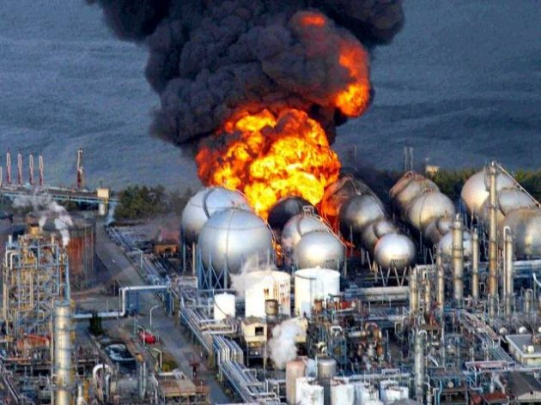
Radiation is measure in unit sievert, which quantifies the amount of radiation absorbed by human tissues
Conversion factor
334 CPM = 1 μ Sv/h
CPM (Counts per minute)
Exposure to 100 mSv an year is the lowest level at which any increase in cancer risk is evident

Slide 5
Objective
To create, train, test, and evaluate ML models to predict the cause of the radiation in case of exposure.
To analyze the exposure of radiation data and its seriousness towards human health
To predict the emission of radiation based on previous data and how harmful it could be

Slide 6
Dataset Information
Name - Safecast Radiation Measurements
Dataset Source - https://www.kaggle.com/safecast/safecast
Size – 10 GB
Years – 2015, 2017
Dataset Format - CSV

Slide 7
Dataset Columns
Column | Description
Captured Time | Time of capture
Latitude | Latitude
Longitude | Longitude
Value | Measurement value
Unit | Unit of the measurement value (e.g. 1cpm)
Device ID | Radiation detection device ID
Height | Height in meters from the ground, not altitude
Surface | Denotes data recorded very close to a surface such as pavement.
Uploaded Time | Time of Upload

Slide 8
Hardware Specification
Databricks Community
Execution: Single Node
Max Storage 2 GB Memory, 0.88 Cores, 1 DBU
Databricks Runtime Version 4.0
Python Version 3
Includes Apache Spark 2.3.0, Scala 2.11
Microsoft Azure ML Studio
Execution: Single Node
Max storage space: 10 GB Memory
The Machine Learning service is a multitenant service

Slide 9
Machine Learning Model in Azure ML studio
Size of Dataset – 33 MB
Algorithms used – Linear Regression and Boosted Decision Tree Regression
Features – Latitude, Longitude and Height
Trained Column – Value (Radiation) in CPM
Split – 70% train and 30% test
Data manipulation tasks Performed
Clip Values Module
Normalize Data

Slide 10
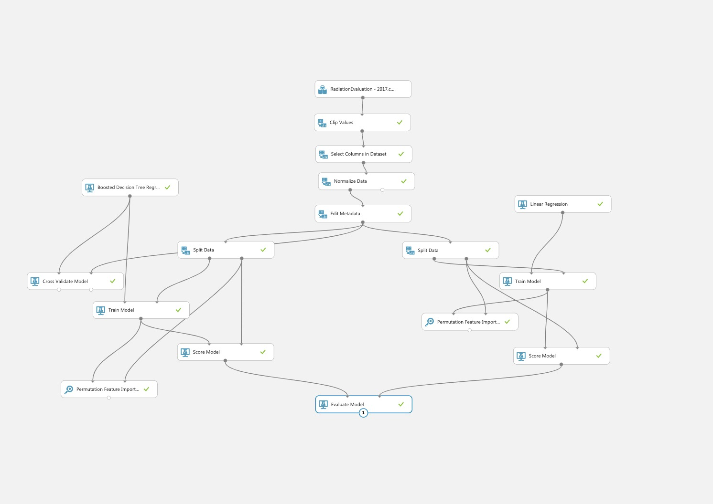
Azure ML studio Model

Slide 11
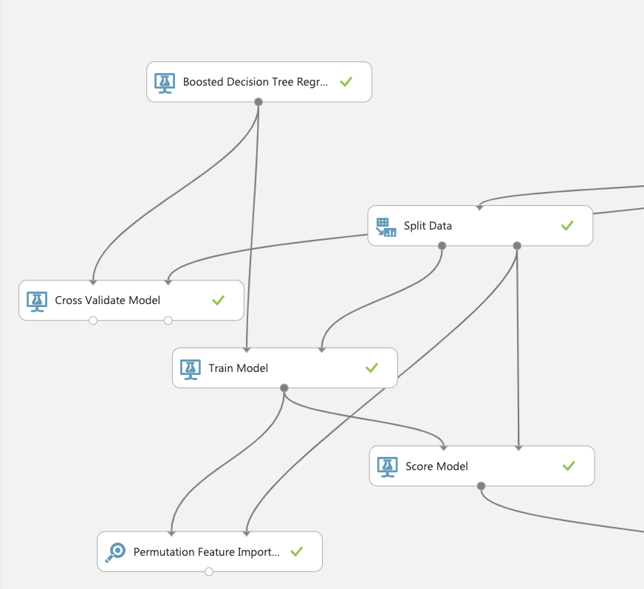
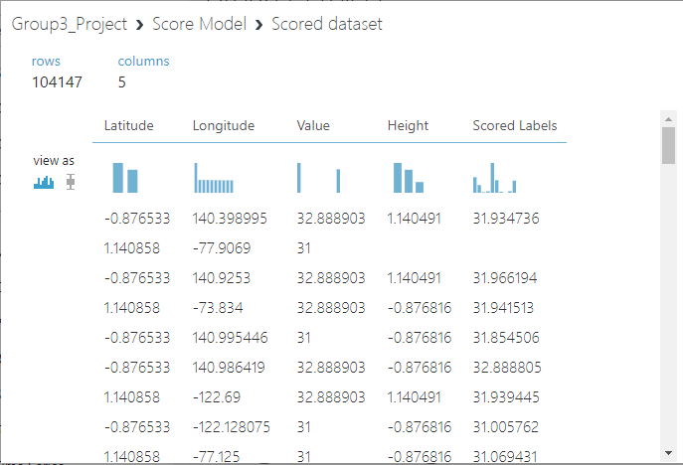
Boosted Decision Tree Regression

Slide 12
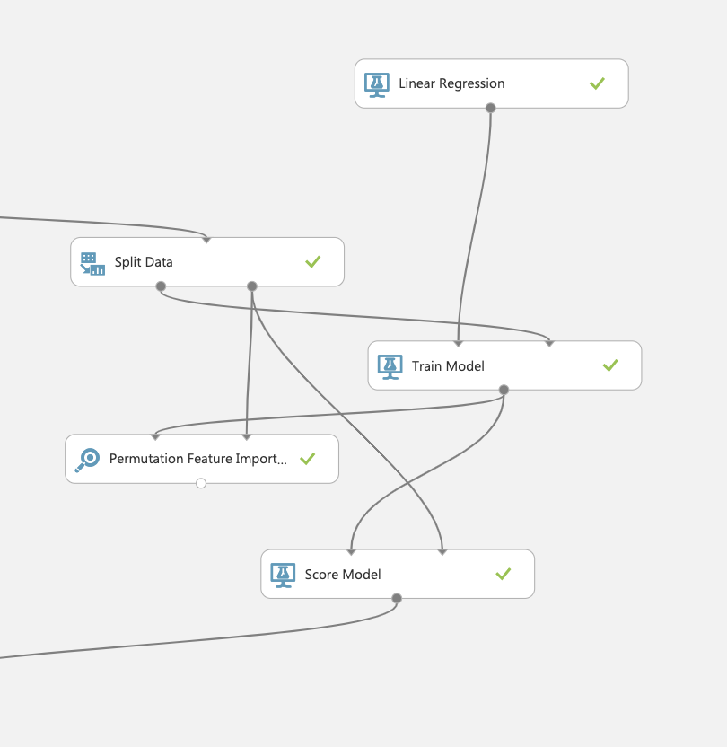
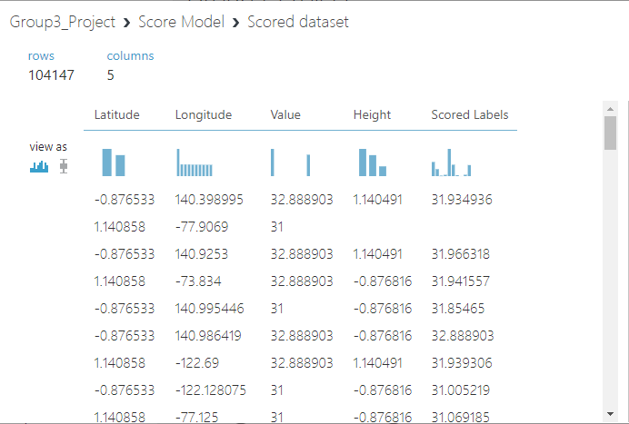
Linear Regression

Slide 13
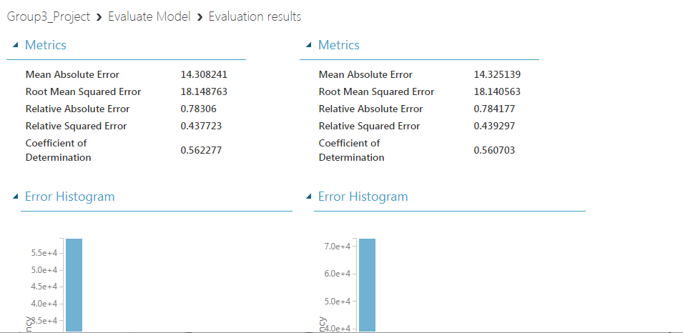
Evaluation Result

Slide 14
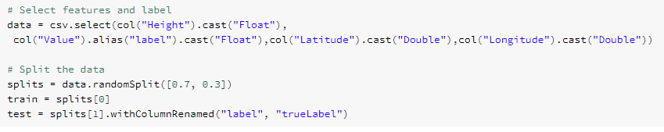
Machine Learning Model in DataBricks
Algorithms used – Linear Regression
Split – 70% train and 30% test

Slide 15
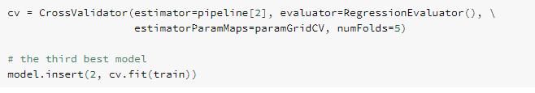
Statistical Analysis
Tune Parameters
We used CrossValidator to evaluate subsets of the data to get statistical analysis of the model.

Slide 16
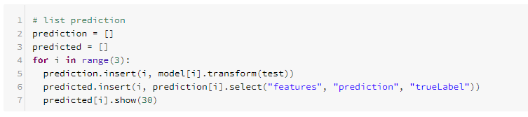
Regression Evaluator

Slide 17
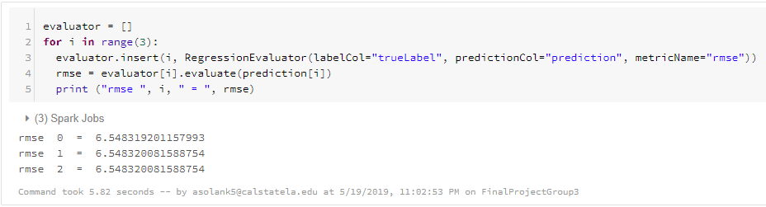
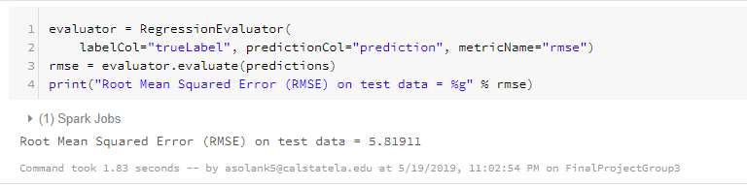
Model Evaluation

Slide 18
References
Dataset Source - https://www.kaggle.com/safecast/safecast
Azure ML Studio – https://gallery.cortanaintelligence.com/Experiment/Group3-Project
Azure Microsoft Docs - https://docs.microsoft.com/en-us/azure/machine-learning/studio-module-reference/machine-learning-studio-algorithm-and-module-help
DataBricks - https://community.cloud.databricks.com/?o=2715954072131794#notebook/1171012282028019

Slide 19

GitHub
https://github.com/asolank5/CIS5560-Safecast-Radiation-Measurements.git

Slide 20

Azure ML
https://gallery.cortanaintelligence.com/Experiment/Group3-Project

